Slide 1
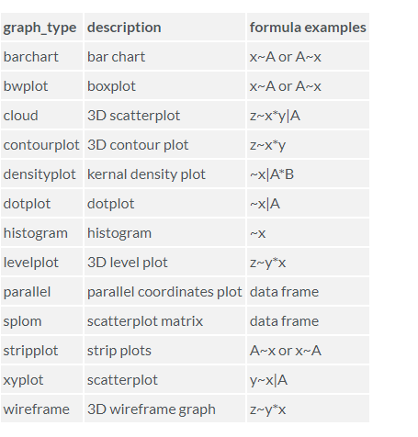
Lattice Package

Slide 2
